Slide 1
Fully customizable feature sets deliver precise solutions with no bloat.
AUGUST 10, 2023
WS
WHISTLESTOP GRIDIRON
Proudly presented to the National Football League
WHO WE ARE

Slide 2
AUGUST 10, 2023
WS
WHISTLESTOP GRIDIRON
WHO WE ARE

Slide 3
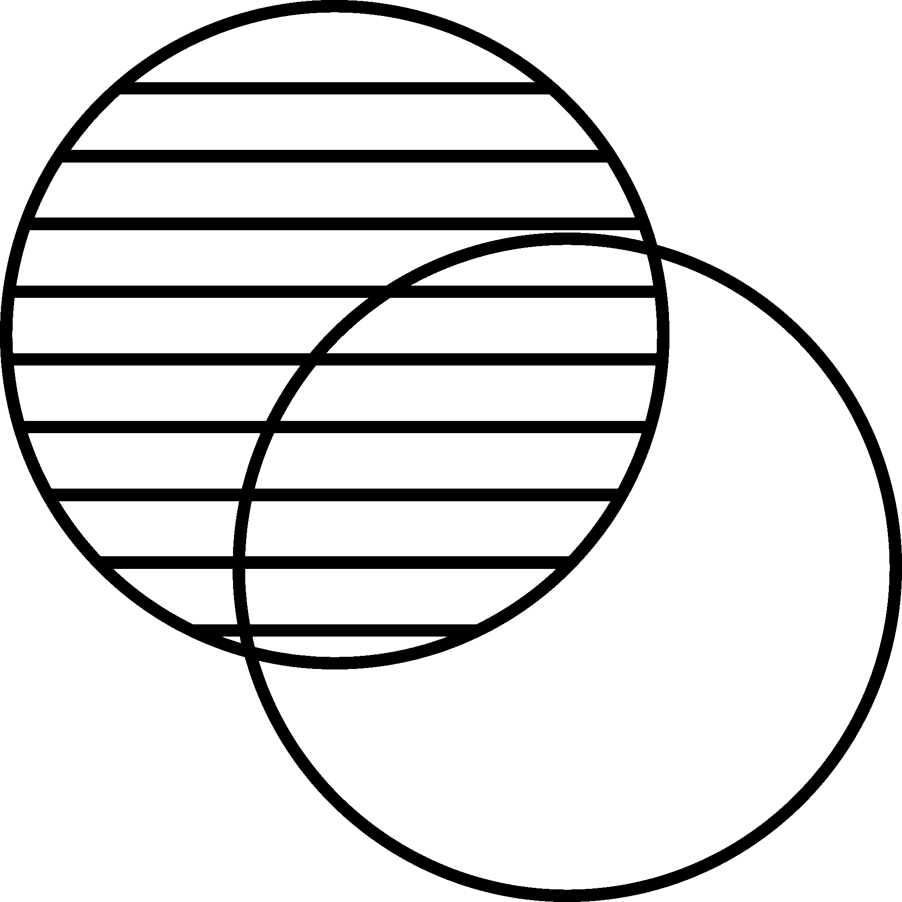
Objectives
AUGUST 10, 2023
ACCURACY
Actively reduce subjectivity related to delay of game correctness of call. GRIDIRON allows the back judge to focus more fully on pre-snap responsibilities while providing an active tool for pace of play rule enforcement.
EFFICIENCY
WHISTLESTOP GRIDIRON
Mitigate human error with available one-touch, visual operations for play clock operators. Dual purpose field packs help keep your broadcasts on time coming out of television breaks.
TRANSPARENCY
Providing NFL officials with 21st century tools elevates trust in the Brand, from fan base to front office.

Slide 4
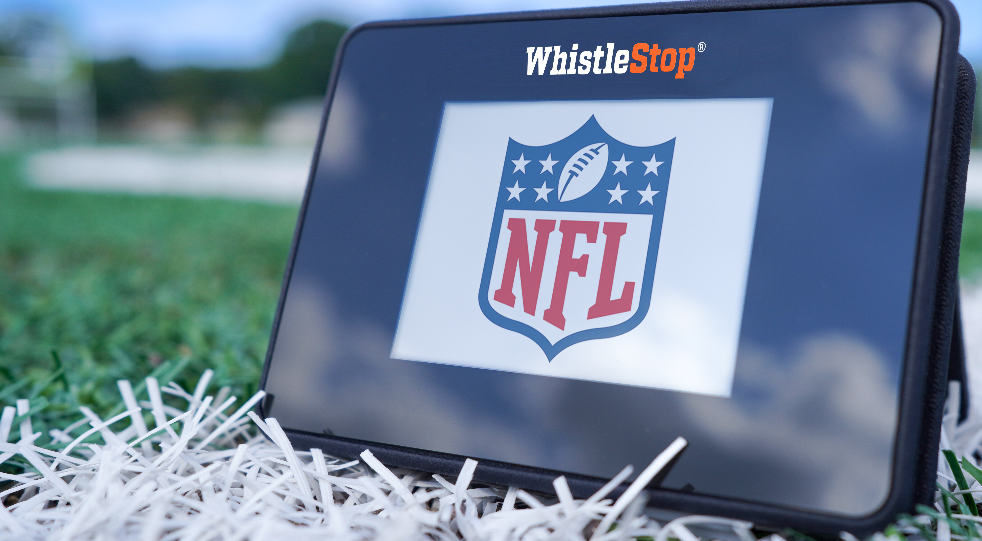
Built for the NFL.
AUGUST 10, 2023
Fully customizable feature sets deliver precise solutions with no bloat.
Choice of touch screen or analog controllers.
Eliminate line-of-sight discrepancies from stadium to stadium.
Fully-synced timing and alerts.
Full integration with existing timing workflow, or customize either controller with only what you need.
Set to 40
Set to 25
Run/Pause
If desired, arm the back judge/referee with the ability to reset/’pump to 25’ from the field to decrease unnecessary stoppages.
WHISTLESTOP GRIDIRON

Slide 5
Mutual goals &
next steps
AUGUST 10, 2023
WHISTLESTOP GRIDIRON
Let’s discuss.
Thank you for your time & consideration!

